Slide 1
Mobile devices help collect and stream data from ecological sensor network into the cloud
Yu-Huang Wang¹, Tony Fountain², Peter Shin², Sheng-Shan Lu¹, Chau-Chin Lin¹, Sara Taghizadeh², Ariana Tsai², Thaddeus Trinh², Mullica Jaroensutasinee³, and Krisanadej Jaroensutasinee³
¹Division of Forest Protection, Taiwan Forestry Research Institute
²University of California, San Diego, CA, USA
³Walailak University, Thailand

Slide 2
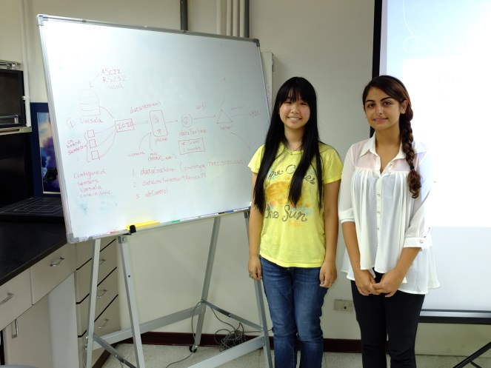
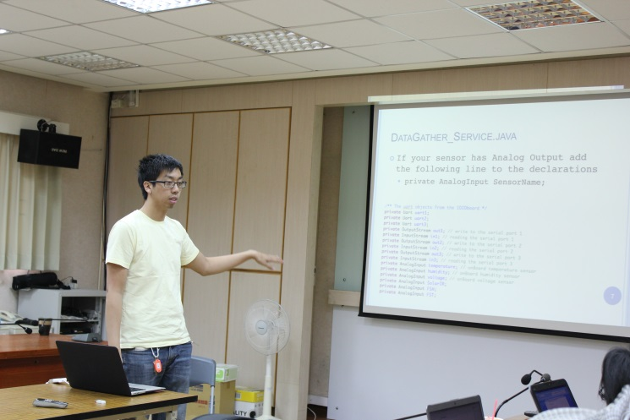
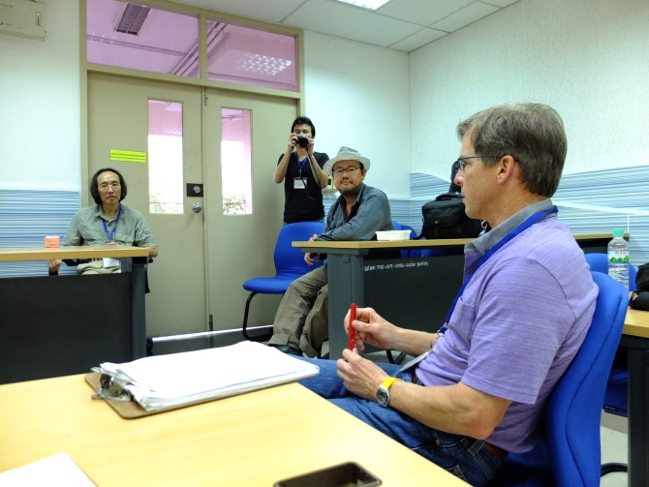
The Story
2010 -2013 PRIME students worked with TFRI
20-22 March 2013, PRAGMA 24 in Bangkok, Thailand
1-5 July 2013, The first SensorPod workshop at TFRI, Taiwan

Slide 3
Objectives of the first SensorPod workshop
To facilitate the exchange of ideas, data, technologies, and methods for using wireless sensor networks for environmental science applications
To identify common scientific agendas and initiate cross-site data analysis applications and collaborations
To reduce the fragmentation of technology and infrastructure in environmental science research groups
To provide international research experience to undergraduate and graduate students in environmental science and sensor network technologies
To enhance existing collaborations and to create new opportunities for technology sharing and scientific research

Slide 4
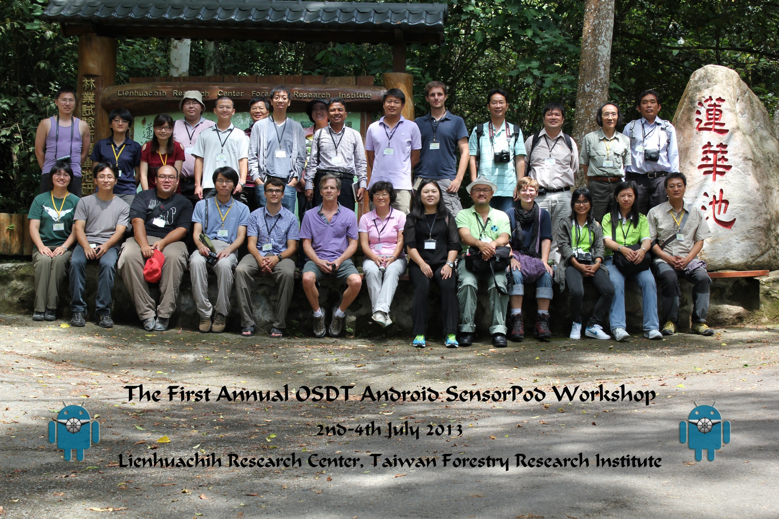
2013 The First SensorPod workshop

Slide 5
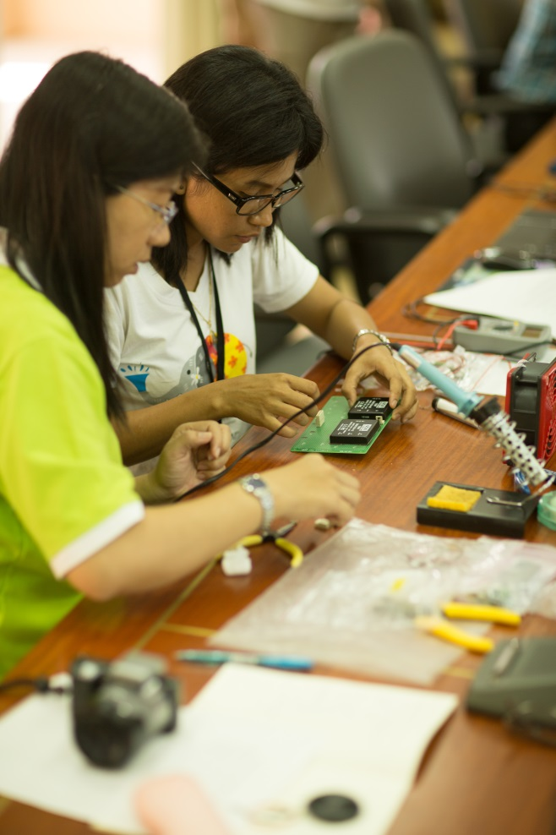
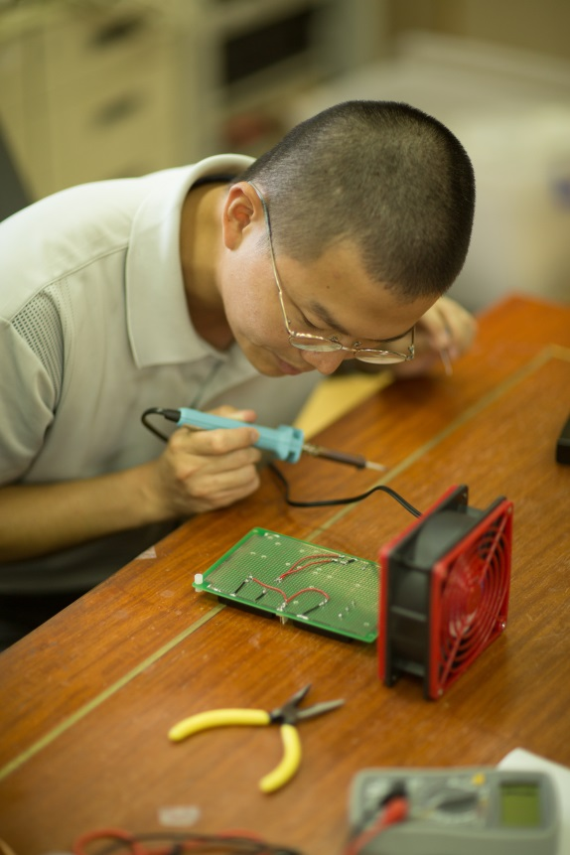
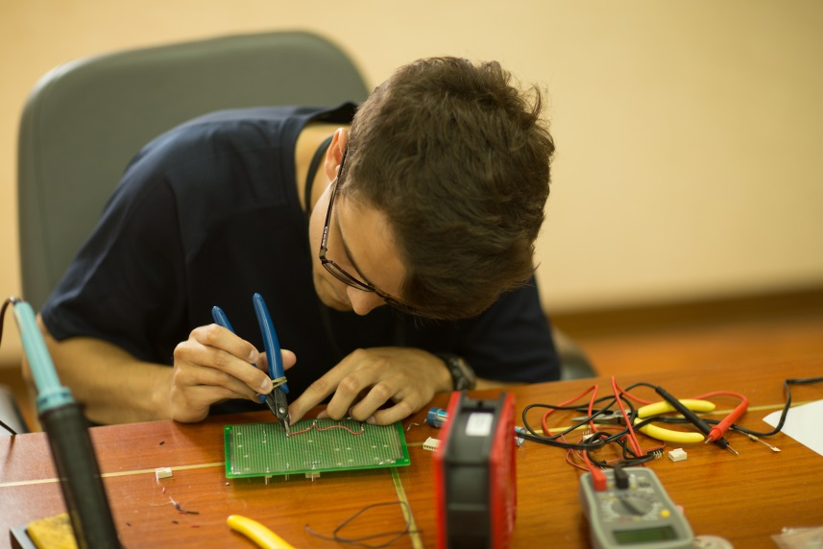
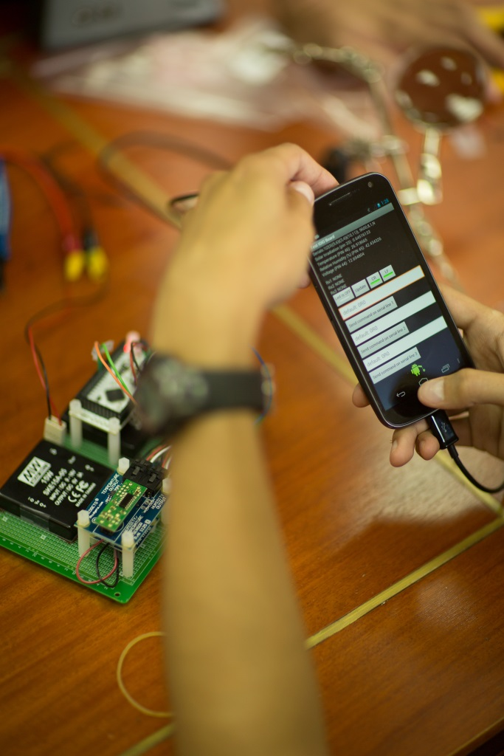
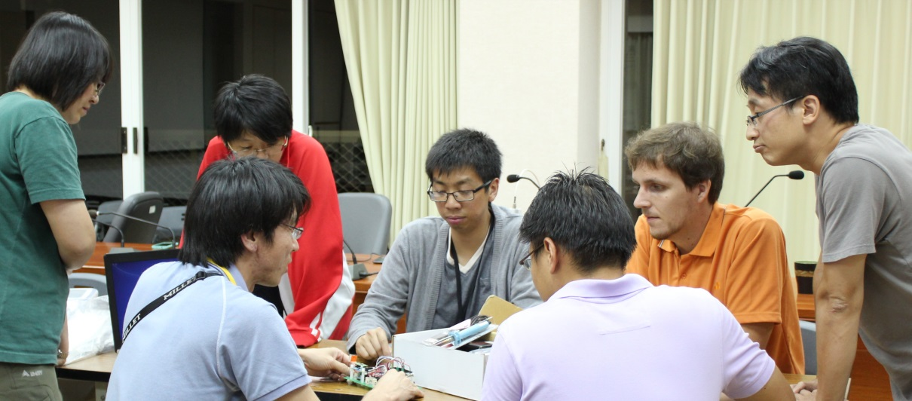
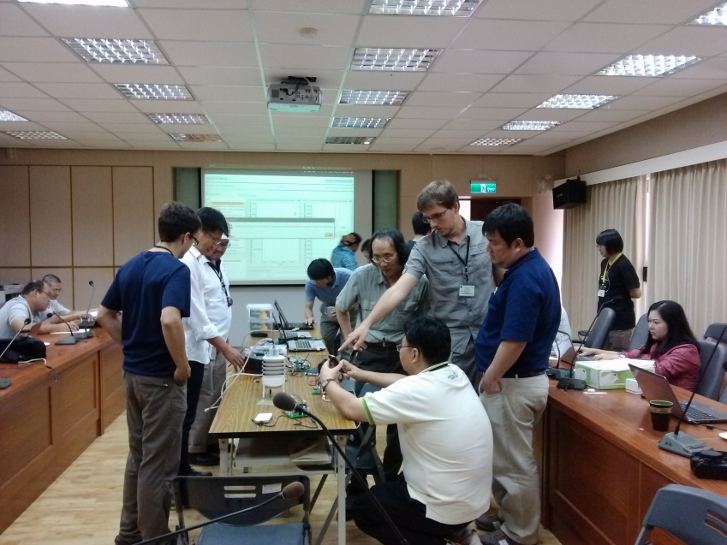

Slide 6
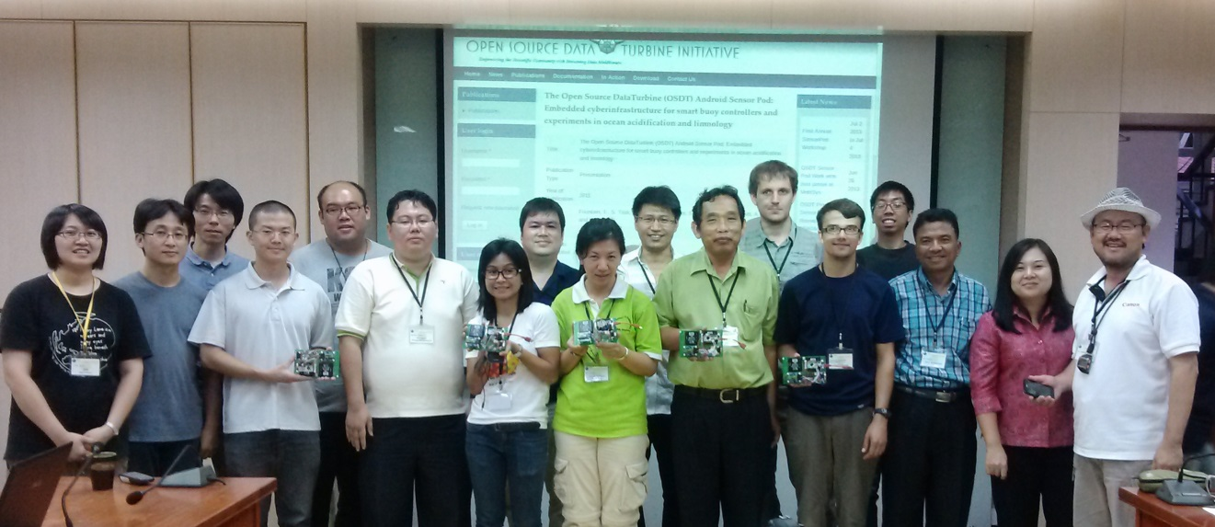
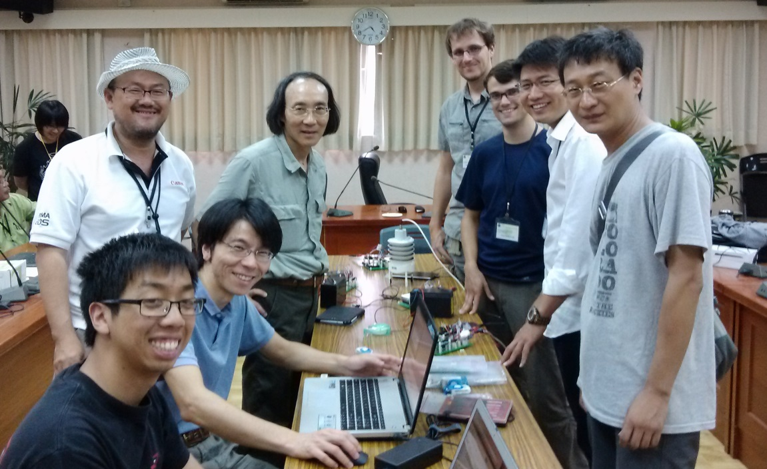
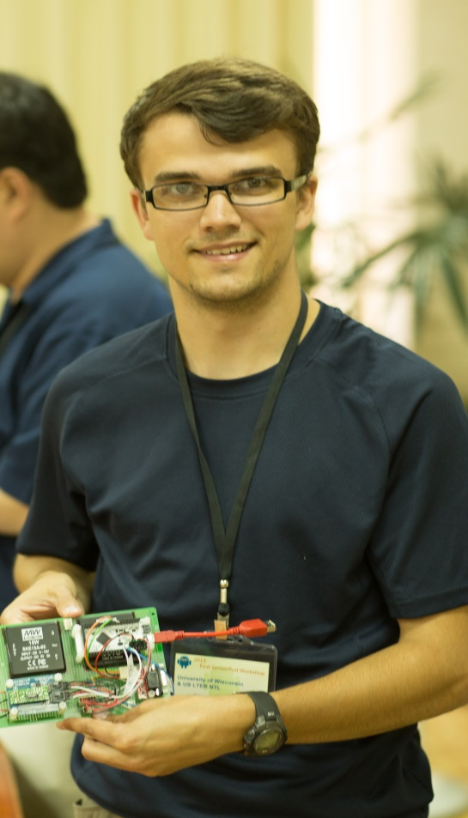

Slide 7
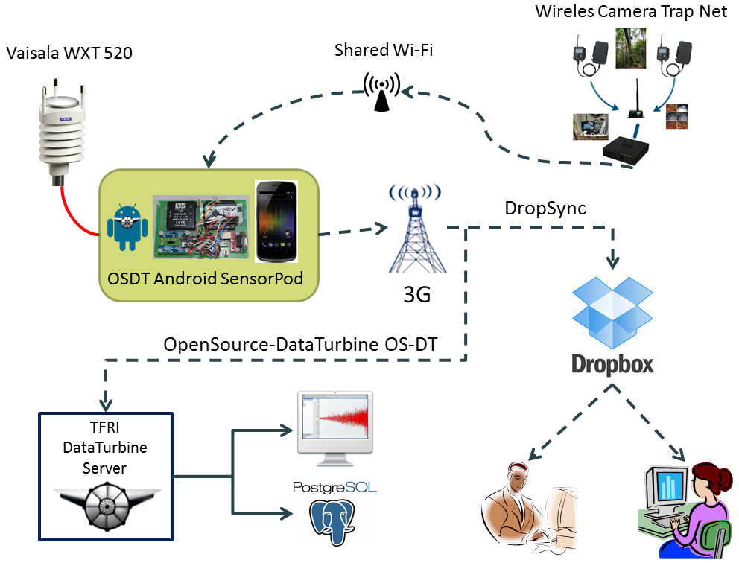

Slide 8
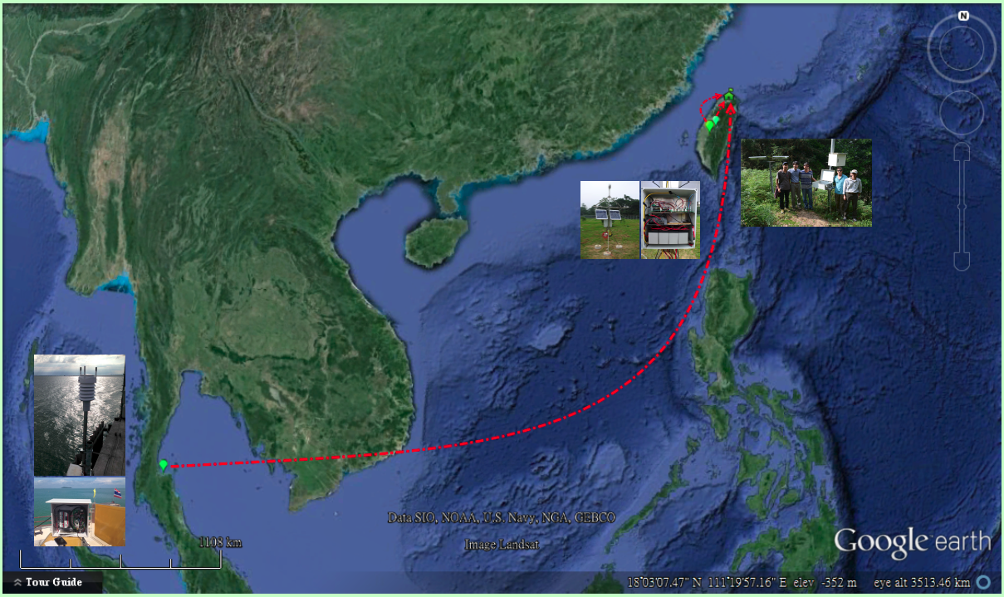
SensorPod Network in Asia

Slide 9
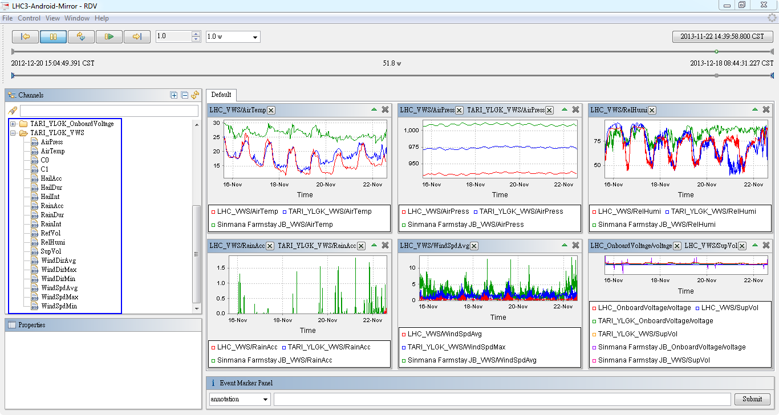
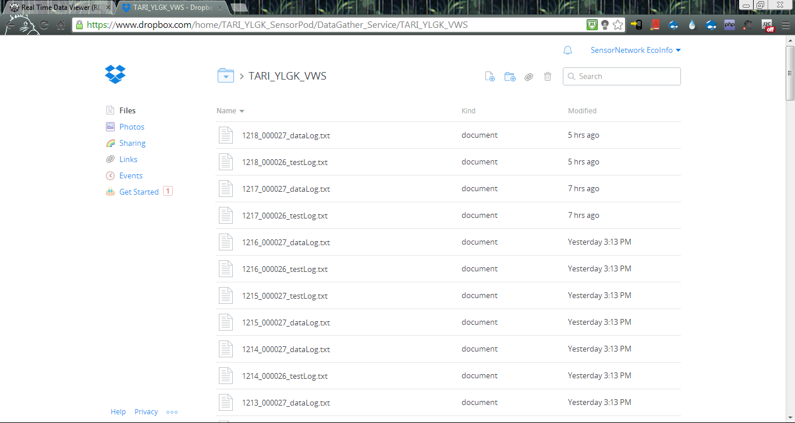

Slide 10
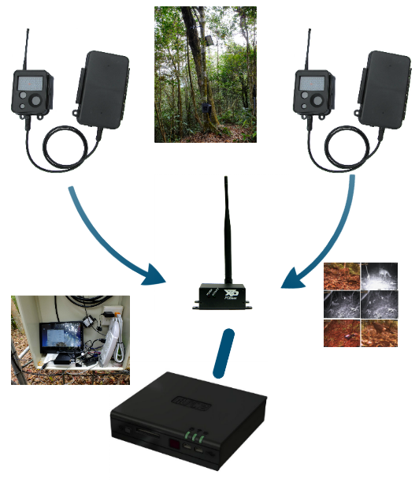

Slide 11
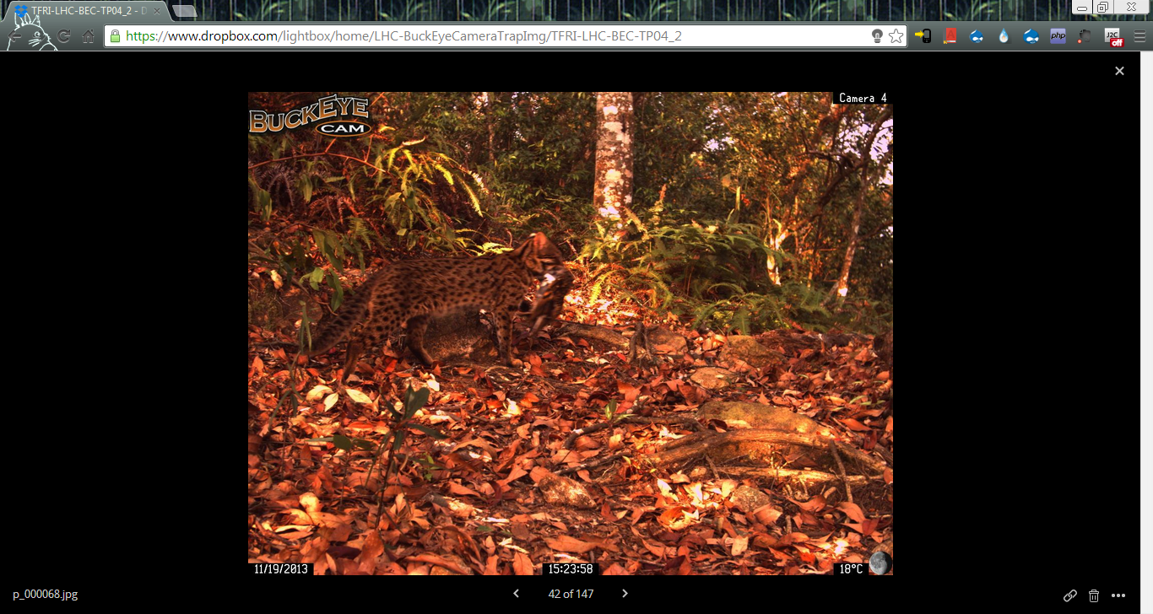

Slide 12
Acknowledgements
The workshop was supported with funding from the Taiwan Forestry Research Institute, and an award to UCSD from the Gordon and Betty Moore Foundation.
The workshop benefitted from additional support from the National Science Foundation (SI2 DataTurbine, PRAGMA, PRIME for undergraduate research experience). The workshop also benefited from the contributions from The Global Lakes Ecological Observatory Network (GLEON), The Coral Reef Environmental Observing Network (CREON), the Long Term Ecological Research Network (LTER), and the International Long Term Ecological Research Network (ILTER).

